Slide 1
웹 버전
배열
(가)
폰트 : 디자인하우스 Bold
AFEW
폰트 : Ramela
Original
BTL Dream Factory
It’s
Original
Creative
Attractive

Slide 2
모바일 버전
배열
(나)
AFEW BTL
Dream Factory
It’s
Original

Slide 3
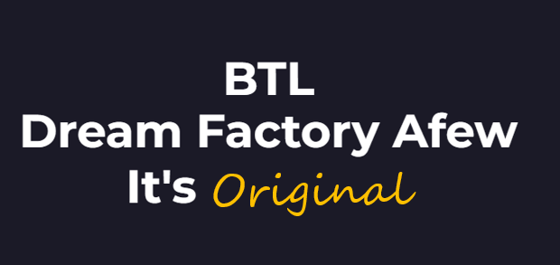
폰트 : Allura
Original
Creative
Original
Attractive

Slide 4
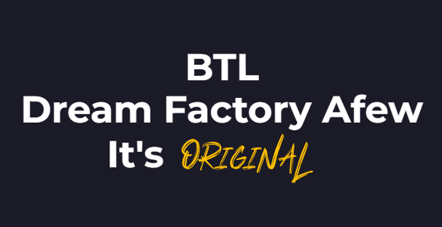
폰트 : BETTER ROLLING Personal Use
ORIGINAL
CREATIVE
ATTRACTIVE

Slide 5
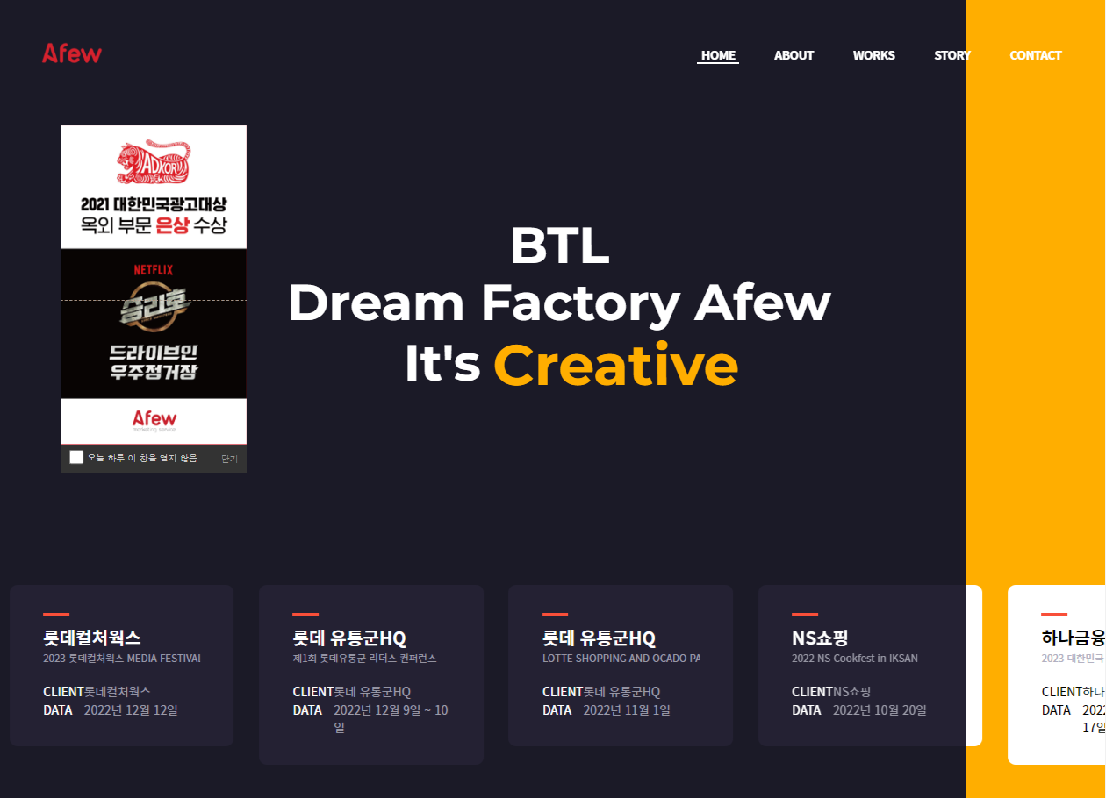
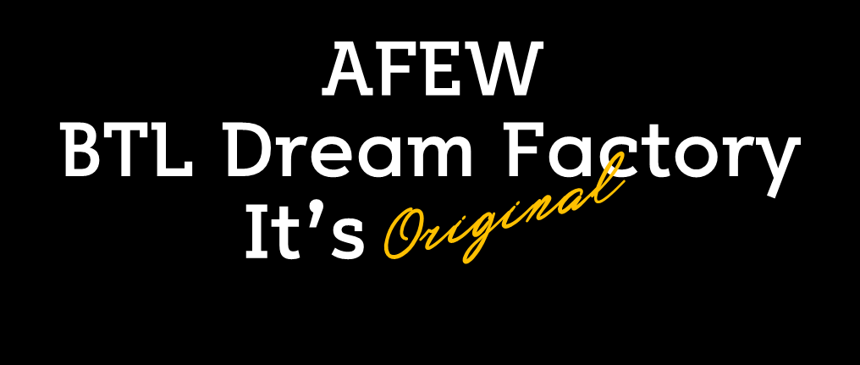
Original
Creative
Attractive

